Slide 1

Progress Seminar On WEBSITE ON HOGWARTS COLLEGE OF WITCHCHART AND WIZARDRY
Presented By
Pushpak Ashwin Fasate
Guided By
Mrs. Roshani Talmale
Department of Computer Science & Engineering
S. B. JAIN INSTITUTE OF TECHNOLOGY MANAGEMENT AND RESEARCH,NAGPUR
An Autonomous Institute, Affiliated to RTMNU, Nagpur

Slide 2
Contents
Objectives
Introduction
Literature survey
Website Design
Technology to be Used
Modules
Screenshots
Advantages & Applications
References
S. B. Jain Institute of Technology Management and Research

Slide 3
Objectives
To Reduce efforts of user.
To Provide full satisfaction to user.
To Provide easy access to the user.
S. B. Jain Institute of Technology Management and Research

Slide 4
Introduction
For this project, I created a website named as Hogwarts Collage Of Witchchart And Wizardry in which I used HTML, CSS programming language. For my project I wanted to work on web development so I created this webpage by taking idea from a fictional Hogwarts University from movie Harry Potter. Users will be able to use the website to know about Hogwarts Collage Of Witchchart And Wizardry. In this website I created different sections / pages for detailed information about Hogwarts where users can visit easily directly through menu bar.
S. B. Jain Institute of Technology Management and Research

Slide 5
Hogwarts collage Of Witchchart and Wizardry
Hogwarts
Course
Gallery
Login
Website Design: Flowchart
Welcome To Hogwarts College
Hogwarts Clubs
Sorting Hat
The wand chooses The Wizard
Discover Your Wand.
Discover Your Patrous
Triwizard
Tournament
Quidditch
HOGWART'S COURSES
HOGWART'S CLUBS
GRYFFINDER
RAVENCLAW
SLYTHERIN
HUFFLEPUFF
Login platform
Sin up platform
HOGWARTS BREAKFAST
HOGWARTS CHRISTMAS
QUIDDITCH HOUSE CUP
THE TRIWIZARD TOURNAMENT
PROFESSOR SERVERUS SNAPE
PROFESSOR MINERVA MCGONAGALL
HOGWART'S EXPRESS
S. B. Jain Institute of Technology Management and Research

Slide 6
Use case Diagram
Hogwarts college Of Witchchart and Wizardry
Start
View navbar
Select item
Login
Register
View menu
Select page
View page
Close

Slide 7
Technology to be Use
Front End:
HTML, CSS
IDE:
vs code
Hardware used:
Laptop , Computer and android phone
S. B. Jain Institute of Technology Management and Research

Slide 8
Modules
Module Names
1. Home
2.Course
3.Gallery
4.log In
S. B. Jain Institute of Technology Management and Research

Slide 9
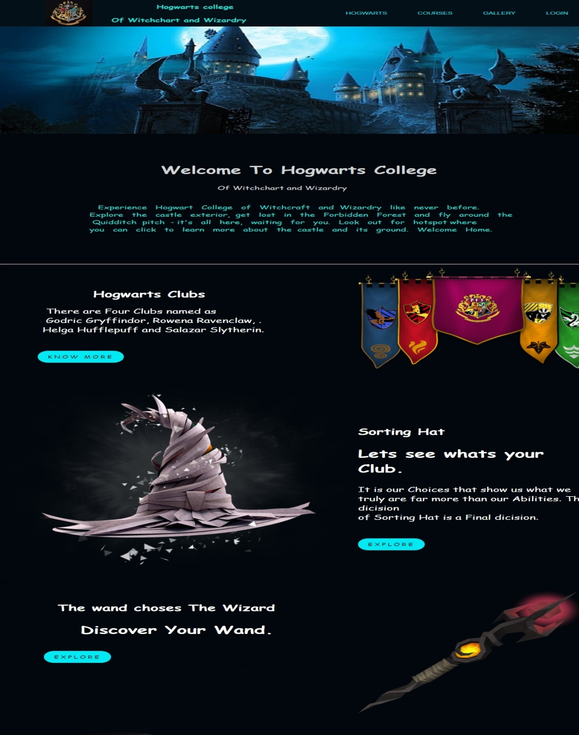

Screen Shots – Home Page
S. B. Jain Institute of Technology Management and Research

Slide 10
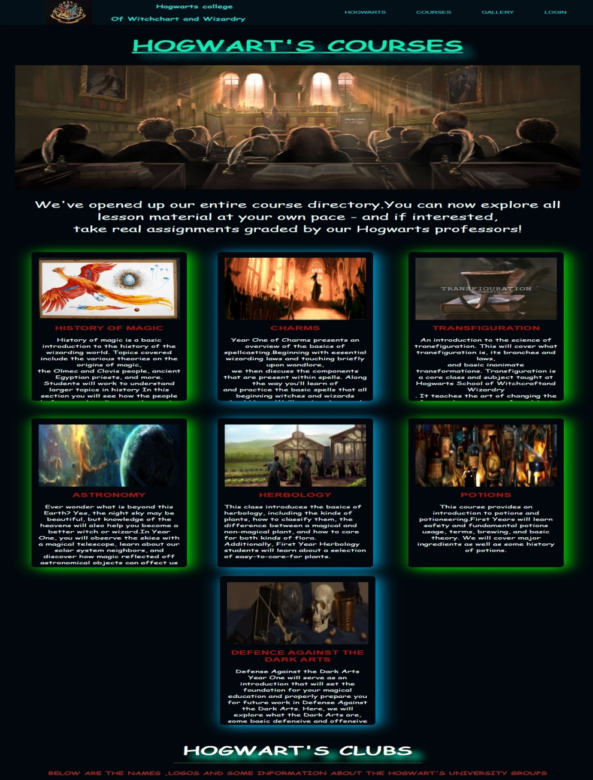

Courses Page

Slide 11
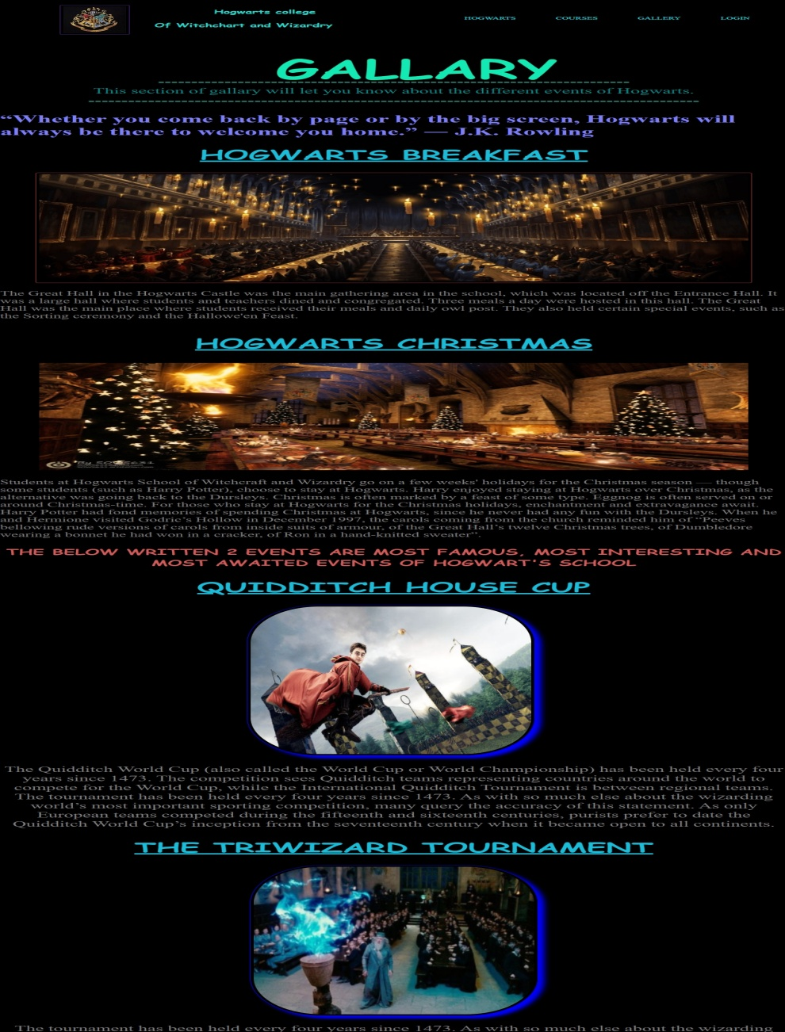
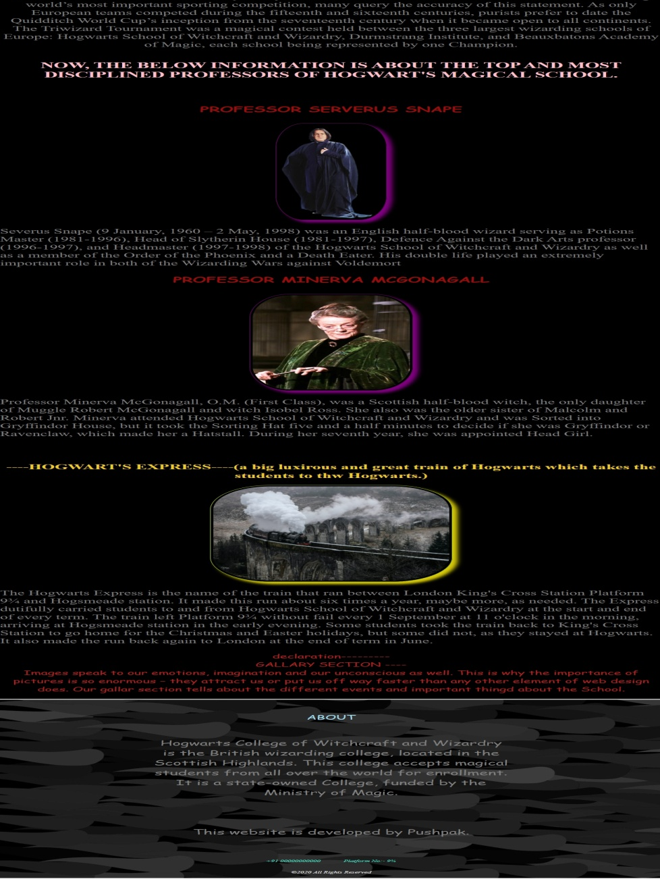
Gallery Page

Slide 12
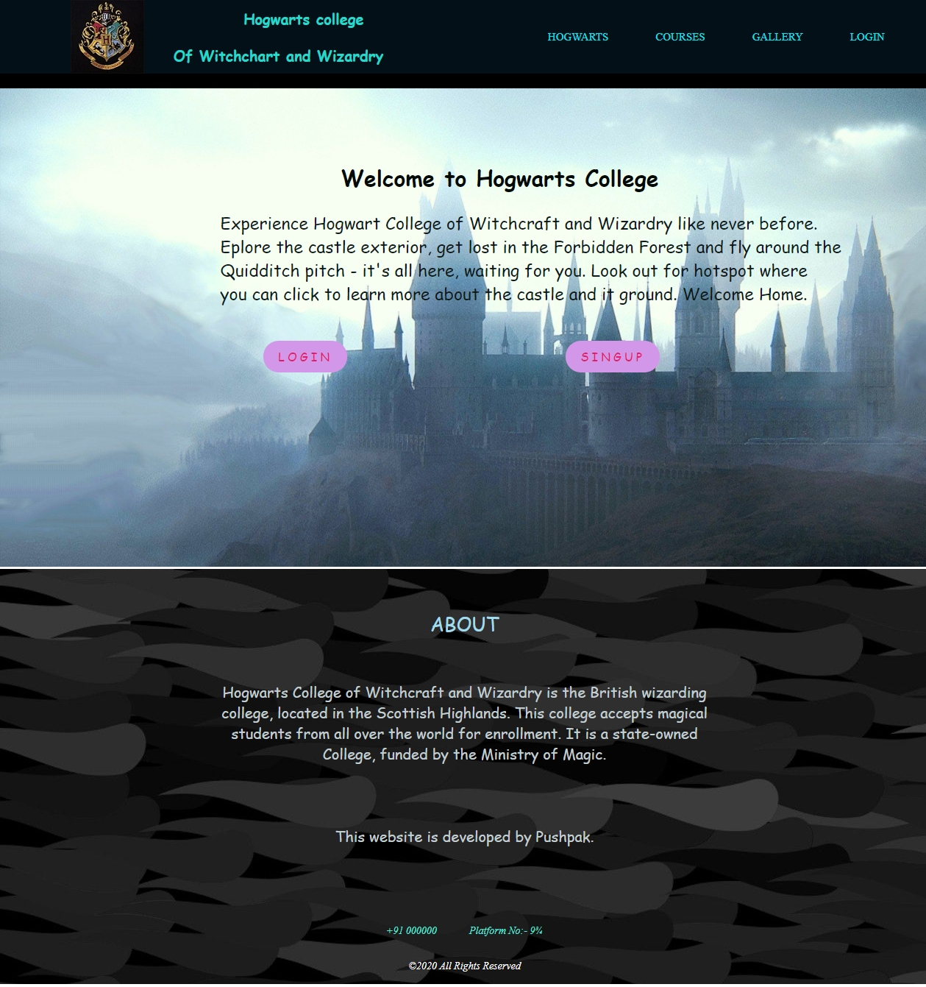
Login And Sign Page

Slide 13
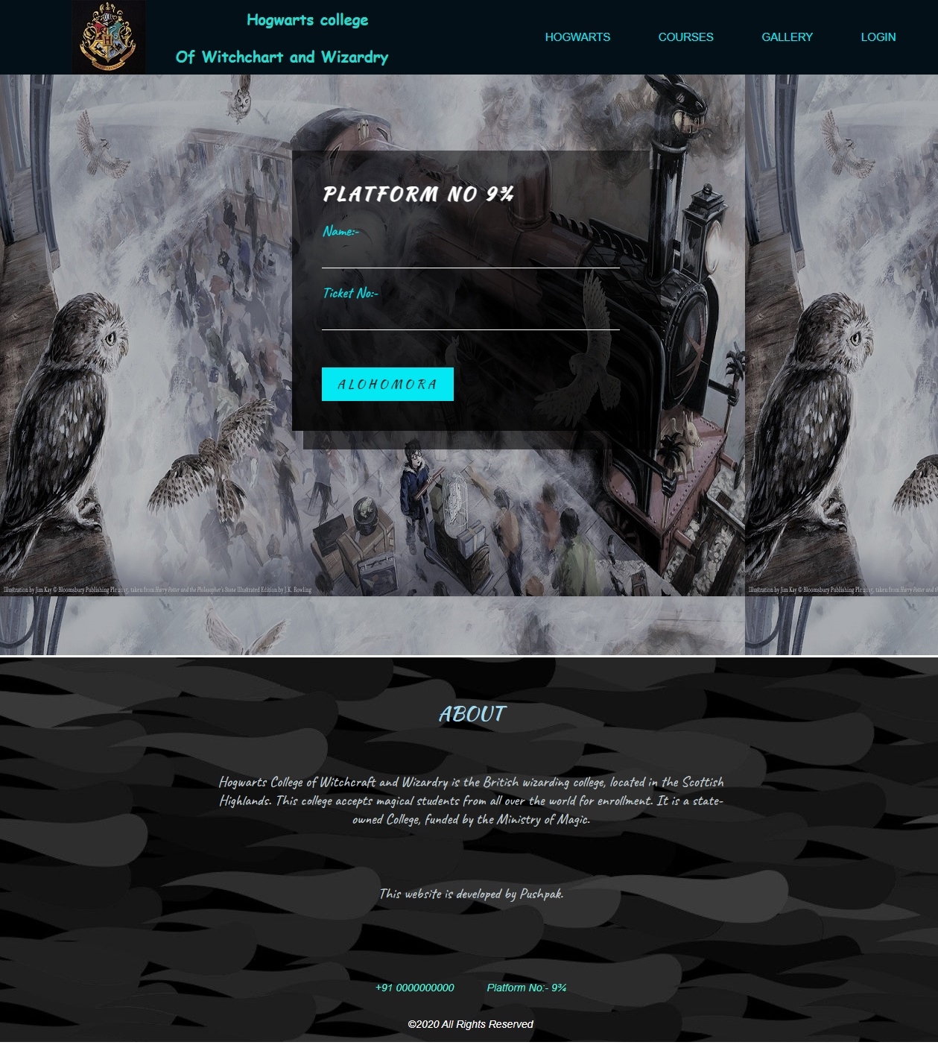
Login Page

Slide 14
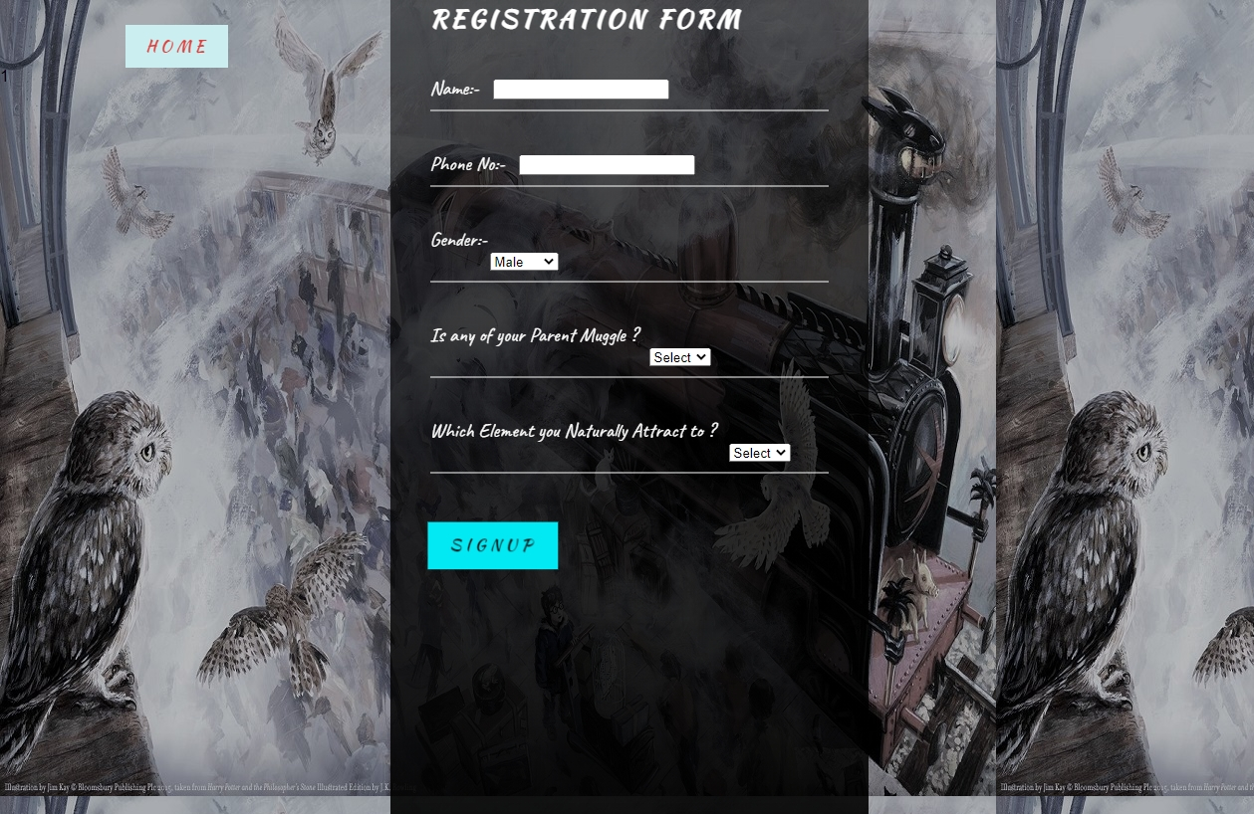
Sign Up Page

Slide 15
Advantages & Applications
Hogwarts college Of Witchchart and Wizardry
S. B. Jain Institute of Technology Management and Research

Slide 16
References
Websites:
www.w3schools.com
www.sololearn.com
www.greatlearning.in
www.geeksforgeeks.org
S. B. Jain Institute of Technology Management and Research

Slide 17
Thank You
S. B. Jain Institute of Technology Management and Research

